Slide 1

Track and Field Olympic Results Analysis

Slide 2
The dataset
Python analysis
Tableau analysis

Slide 3
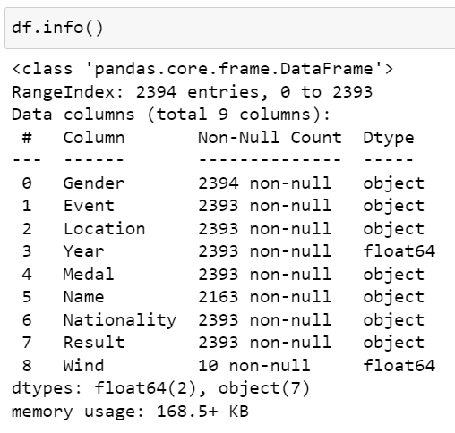
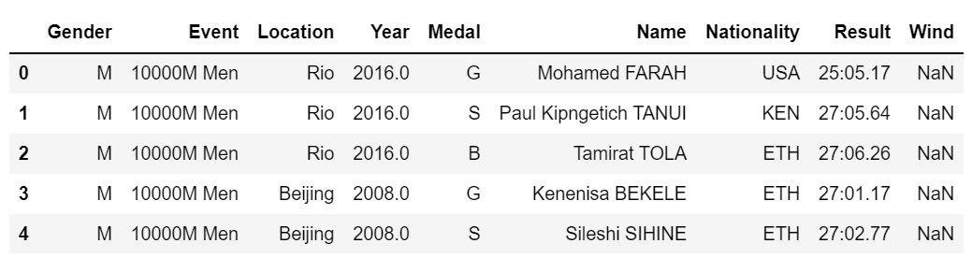
The data:

Slide 4
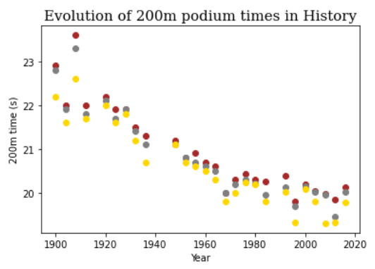
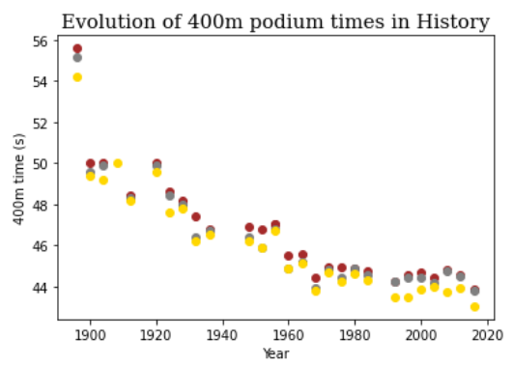
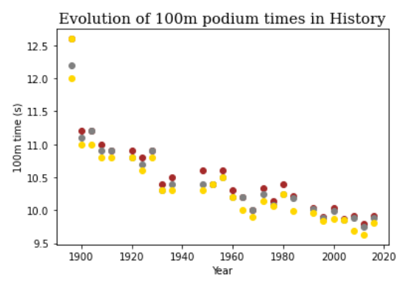
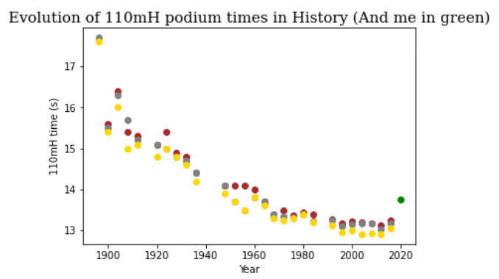
Python analysis

Slide 5
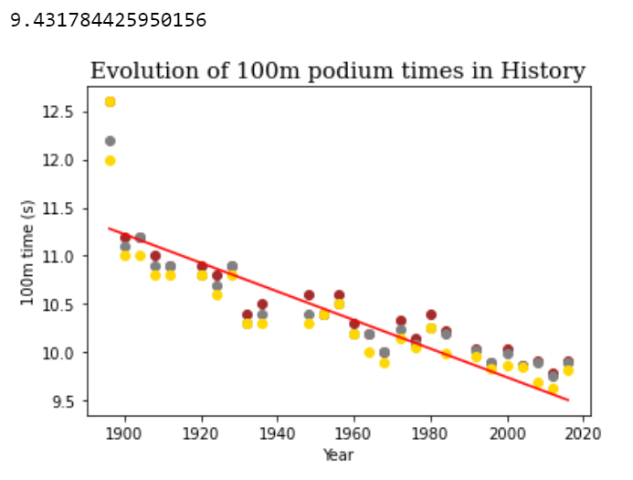
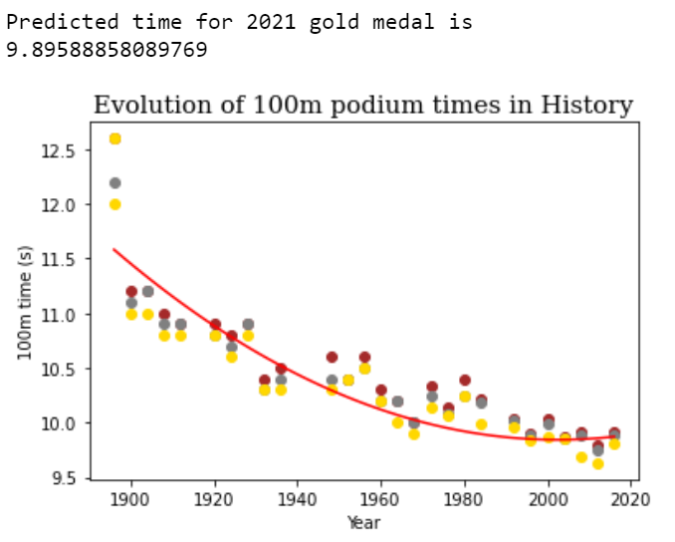
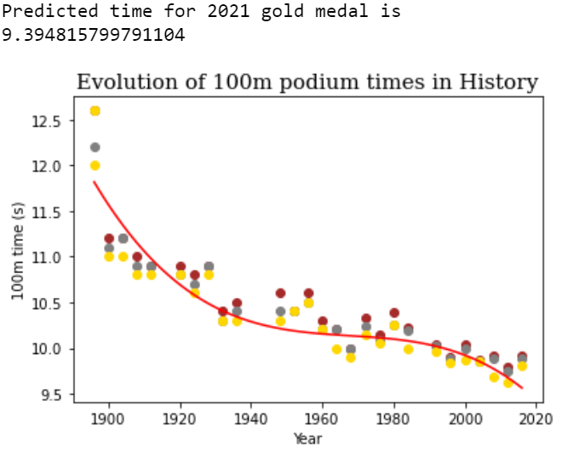
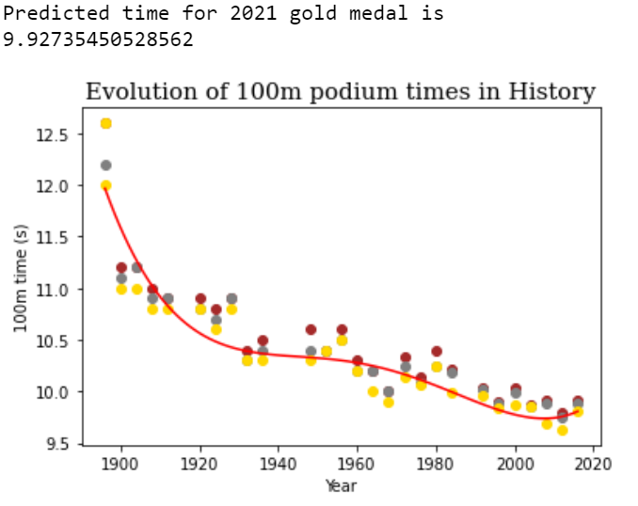
Trend analysis

Slide 6
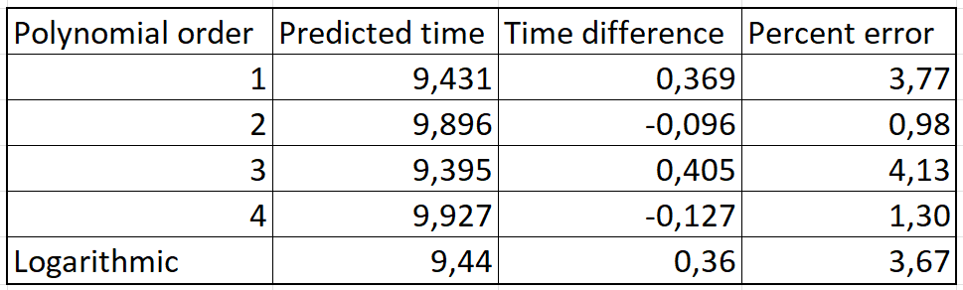
Prediction
Tokyo 2021 100m winning time : 9.80s (Lamont Marcell Jacobs , Italy)

Slide 7
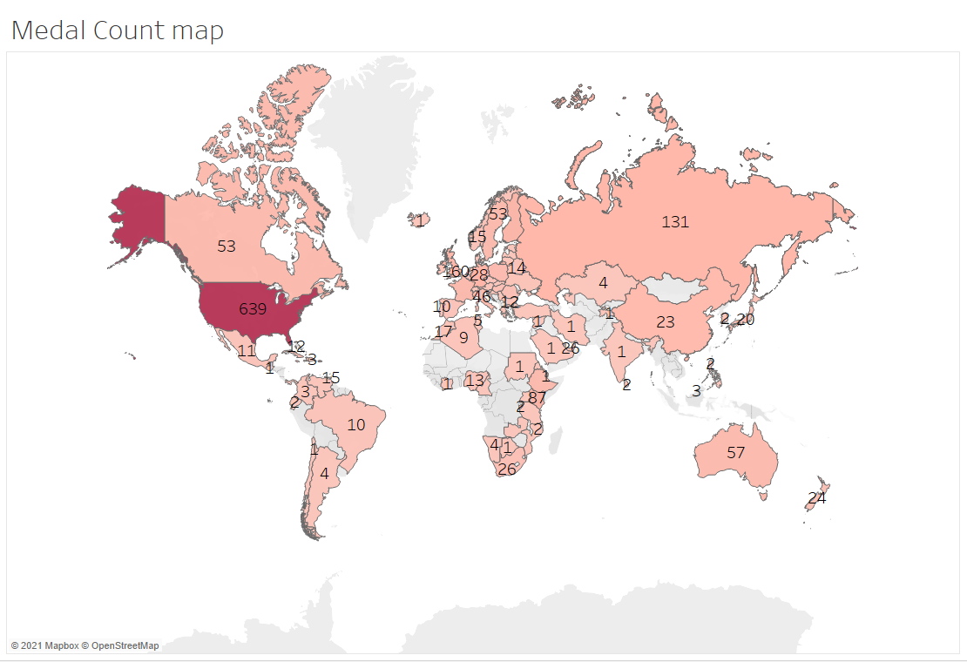
Geographical analysis ( Tableau)

Slide 8
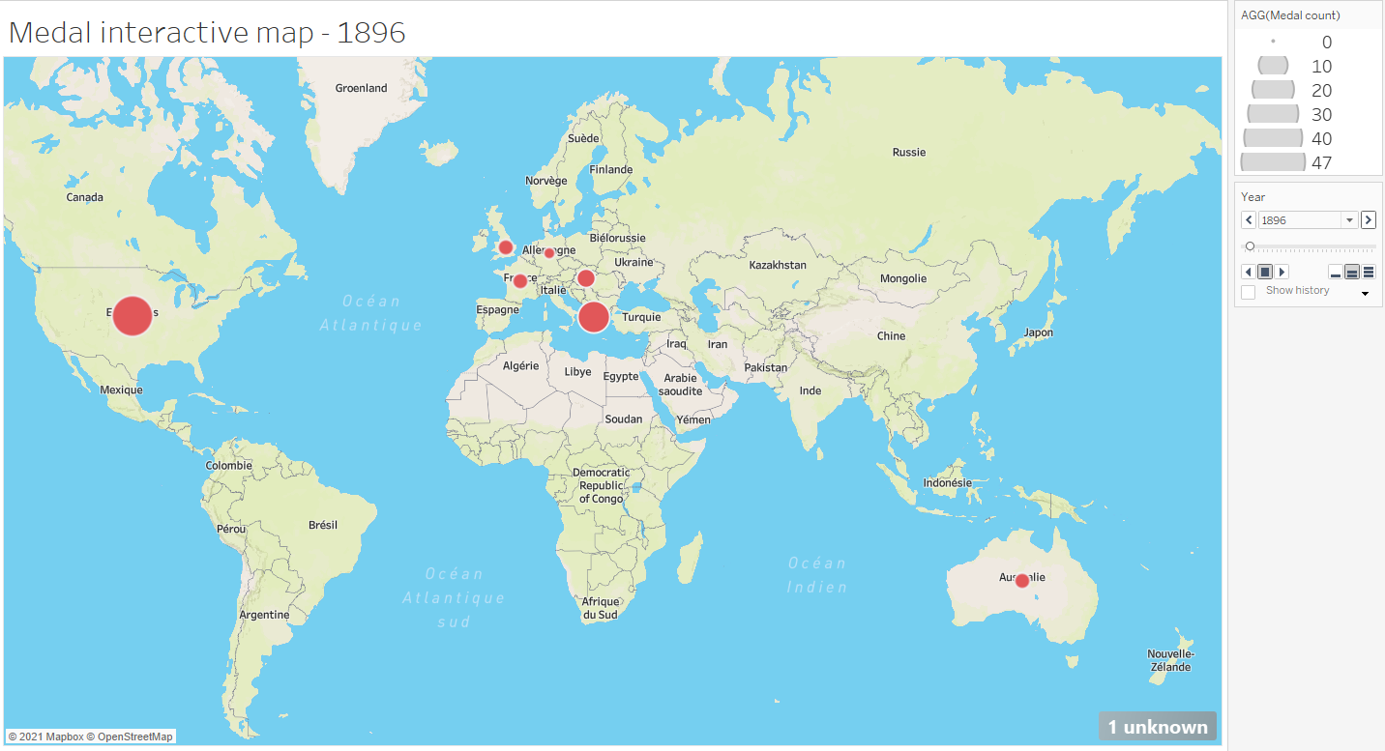
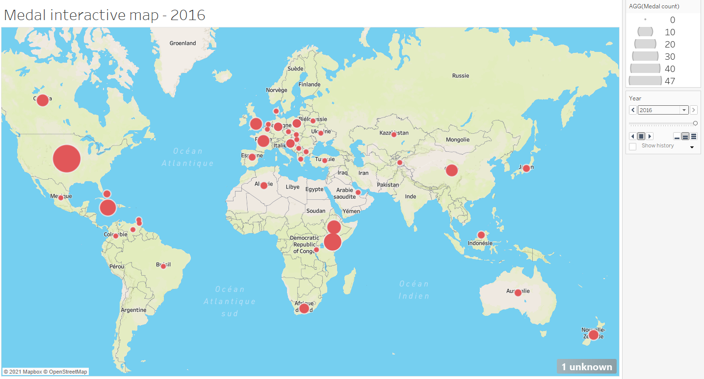
From 1896 to 2016 : Globalization of Track & Field

Slide 9
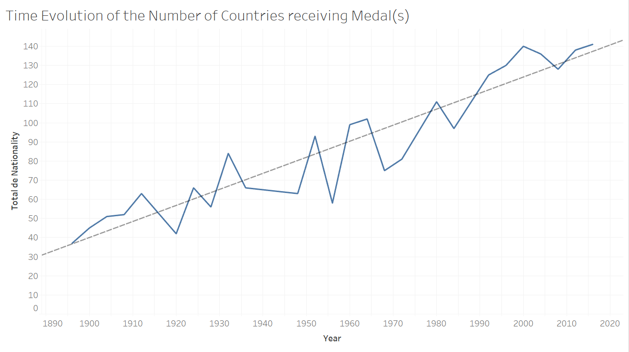
Evolution of the countries represented

Slide 10
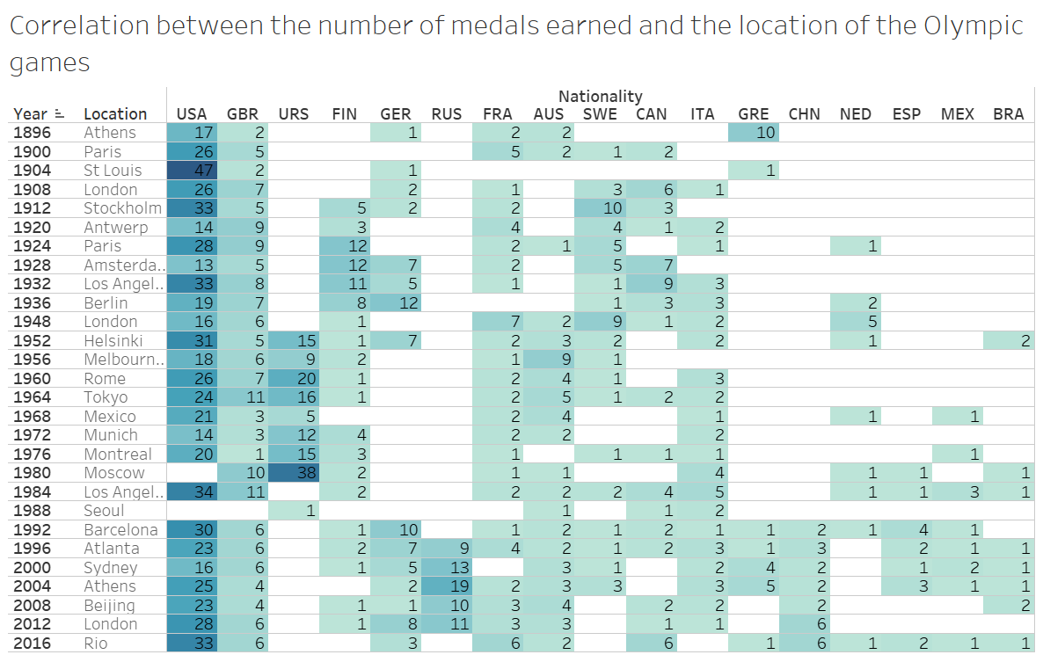

Slide 11
Limitations :
Incomplete data :
Conditions can affect performances (wind, altitude, temperature)
Politics can affect performances (Democratization of a sport, popularity)
Example : India vs Jamaica
Track and field is not a precise science

Slide 12

Question

